Slide 1



Java Collection

Slide 2
Collections in Java
The Collection in Java is a framework that provides an architecture to store and manipulate the group of objects.
Java Collections can achieve all the operations that you perform on a data such as searching, sorting, insertion, manipulation, and deletion.
Java Collection means a single unit of objects. Java Collection framework provides many interfaces (Set, List, Queue, Deque) and classes (ArrayList, Vector, LinkedList, PriorityQueue, HashSet, LinkedHashSet, TreeSet).

Slide 3
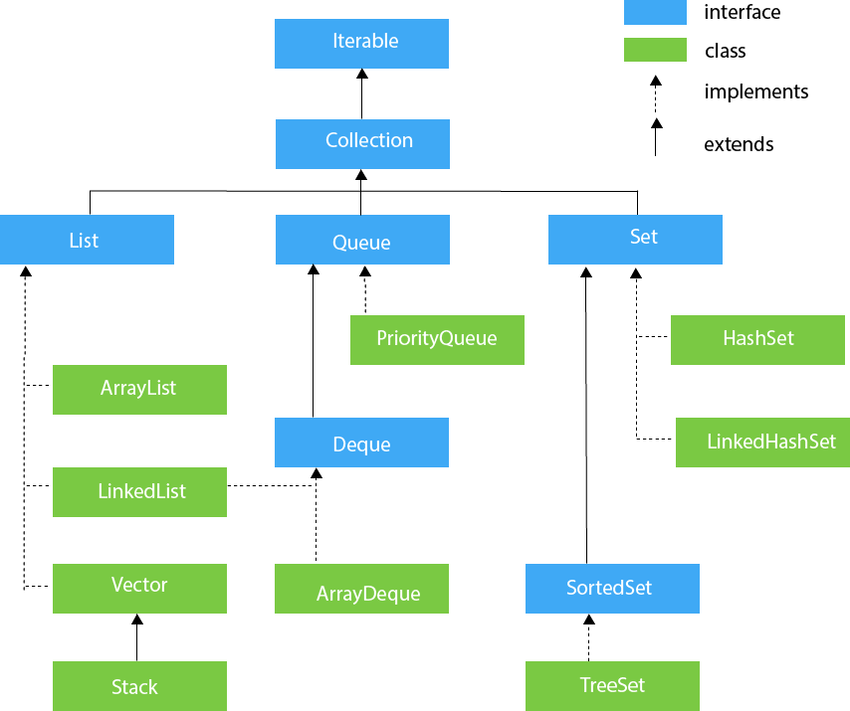
Hierarchy of Collection Framework
The java.util package contains all the classes and interfaces for the Collection framework.

Slide 4
List Interface
ArrayList
LinkedList
Vector
It uses a dynamic array to store the duplicate element of different data types.
It uses a doubly linked list internally to store the elements. It can store the duplicate elements. It maintains the insertion order and is not synchronized.
Vector uses a dynamic array to store the data elements. It is similar to ArrayList. However, It is synchronized and contains many methods that are not the part of Collection framework.
Locate(get) fast
Add/remove slow
Locate(get) slow
Add/remove fast
Thread safely

Slide 5
Queue Interface
PriorityQueue
Deque Interface
ArrayDeque
The PriorityQueue class implements the Queue interface. It holds the elements or objects which are to be processed by their priorities.
Deque interface extends the Queue interface. In Deque, we can remove and add the elements from both the side. Deque stands for a double-ended queue which enables us to perform the operations at both the ends.
ArrayDeque is faster than ArrayList and Stack and has no capacity restrictions.
Locate(get) slow
Add/remove fast
null values not allowed.

Slide 6
Set Interfase
HashSet
LinkedHashSet
SortedSet
TreeSet
It represents the collection that uses a hash table for storage. Hashing is used to store the elements in the HashSet. It contains unique items.
LinkedHashSet class represents the LinkedList implementation of Set Interface.
Null is not allowed
Not stored by insert order
Null is allowed
Insert Order is saved
Save in ascending order

Slide 7
Java Map Interface
A map contains values on the basis of key, i.e. key and value pair. Each key and value pair is known as an entry. A Map contains unique keys.
A Map is useful if you have to search, update or delete elements on the basis of a key.

Slide 8
HashMap
LinkedHashMap
SortedMap
TreeMap
HashMap is the implementation of Map, but it doesn't maintain any order.
LinkedHashMap is the implementation of Map. It inherits HashMap class. It maintains insertion order.
TreeMap is the implementation of Map and SortedMap. It maintains ascending order.

Slide 9
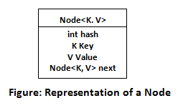
Working of HashMap in Java
What is Hashing
It is the process of converting an object into an integer value. The integer value helps in indexing and faster searches.
What is HashMap
HashMap is a part of the Java collection framework. It uses a technique called Hashing. It implements the map interface. It stores the data in the pair of Key and Value. HashMap contains an array of the nodes, and the node is represented as a class. It uses an array and LinkedList data structure internally for storing Key and Value. There are four fields in HashMap.

Slide 10
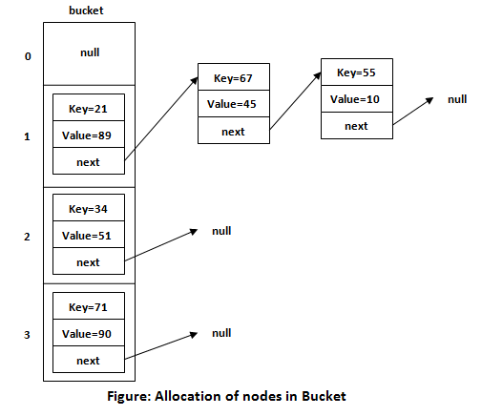
Before understanding the internal working of HashMap, you must be aware of hashCode() and equals() method.
equals(): It checks the equality of two objects. It compares the Key, whether they are equal or not. It is a method of the Object class. It can be overridden. If you override the equals() method, then it is mandatory to override the hashCode() method.
hashCode(): This is the method of the object class. It returns the memory reference of the object in integer form. The value received from the method is used as the bucket number. The bucket number is the address of the element inside the map. Hash code of null Key is 0.
Buckets: Array of the node is called buckets. Each node has a data structure like a LinkedList. More than one node can share the same bucket. It may be different in capacity.

Slide 11
Insert Key, Value pair in HashMap
We use put() method to insert the Key and Value pair in the HashMap. The default size of HashMap is 16 (0 to 15).
Example
In the following example, we want to insert three (Key, Value) pair in the HashMap.
HashMap<String, Integer> map = new HashMap<>();
map.put("Aman", 19);
map.put("Sunny", 29);
map.put("Ritesh", 39);
Let's see at which index the Key, value pair will be saved into HashMap. When we call the put() method, then it calculates the hash code of the Key "Aman." Suppose the hash code of "Aman" is 2657860. To store the Key in memory, we have to calculate the index.

Slide 12
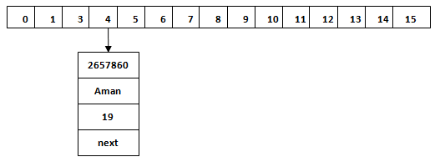
Calculating Index
Index minimizes the size of the array. The Formula for calculating the index is:
Index = hashcode(Key) & (n-1)
Where n is the size of the array. Hence the index value for "Aman" is:
Index = 2657860 & (16-1) = 4
The value 4 is the computed index value where the Key and value will store in HashMap.

Slide 13
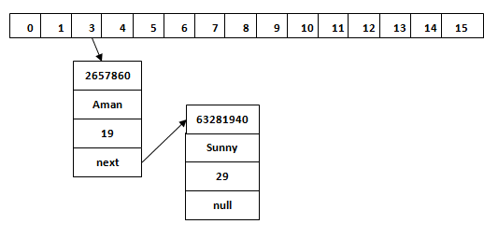
Hash Collision
This is the case when the calculated index value is the same for two or more Keys.
Let's calculate the hash code for another Key "Sunny." Suppose the hash code for "Sunny" is 63281940. To store the Key in the memory, we have to calculate index by using the index formula.
Index=63281940 & (16-1) = 4
In this case, equals() method check that both Keys are equal or not.
If Keys are same, replace the value with the current value.
Otherwise, connect this node object to the existing node object through the LinkedList. Hence both Keys will be stored at index 4.

Slide 14
get() method in HashMap
When get(K Key) method is called, it calculates the hash code of the Key.
Example
map.get(new Key("Aman"));
Hashcode match -> if the linkedList.size() == 1, return this value
if the linkedList.size() > 1, check equals method to find the entry

Slide 15

Thank You

